Slide 1

https://xkcd.com/2353

Slide 2
Reviewing Sea Spray-Mediated Air-Sea Fluxes of Enthalpy and Momentum in Tropical Cyclones
Sydney Sroka
Massachusetts Institute of Technology
February 23, 2021
Atmosphere-Ocean Seminar
Imperial College
Notes:
How sea spray mediates the boundary layer fluxes that ultimately drive hurricane intensification

Slide 3
Outline
0. Background
I. Sensitivity Analysis
Motivation: Improve hurricane intensity forecasts
Hurricane intensity depends on air-sea enthalpy and momentum fluxes
What do spray-mediated fluxes depend on?
What are they most sensitive to?
II. Synthesis of Previous Work
What trends or common
findings exist in the literature?

Slide 4
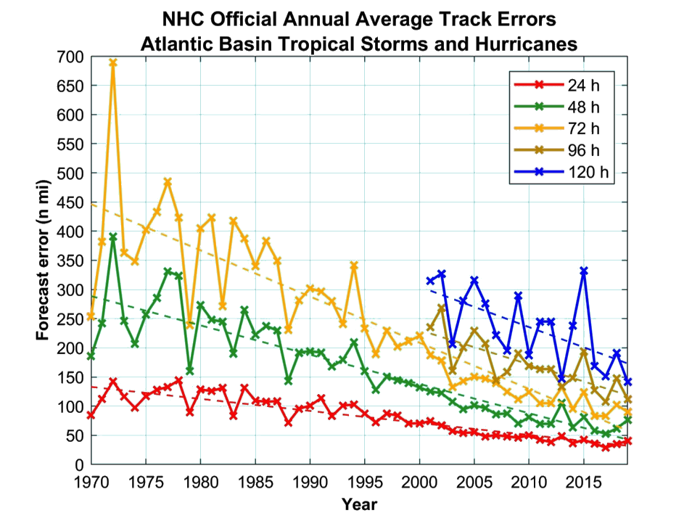
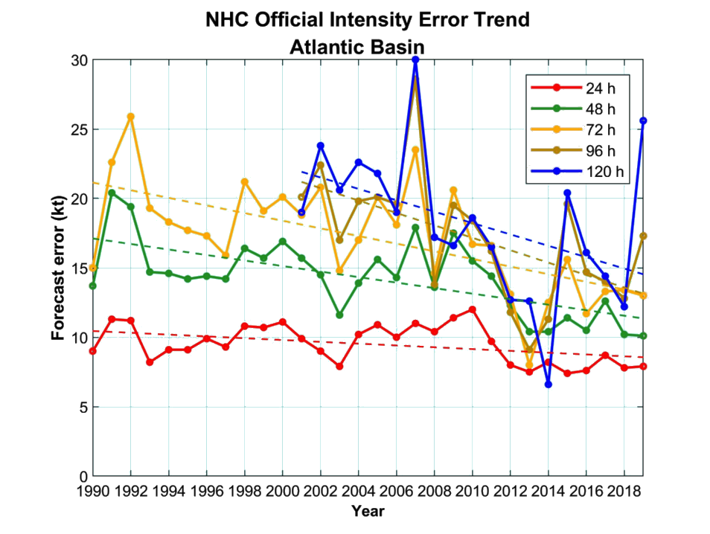
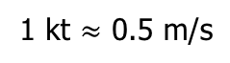
Motivation: Improve Hurricane Intensity Forecasts
Error in storm’s location
Error in storm’s wind speed
48 hr track error
~75% error reduction
48 hr intensity error
~35% error reduction
[source: The National Hurricane Center]
Category
1
2
3
4
5
Wind Speed (kt)
1 kt $≈$ 0.5 m/s
64
83
96
113
137

Slide 5

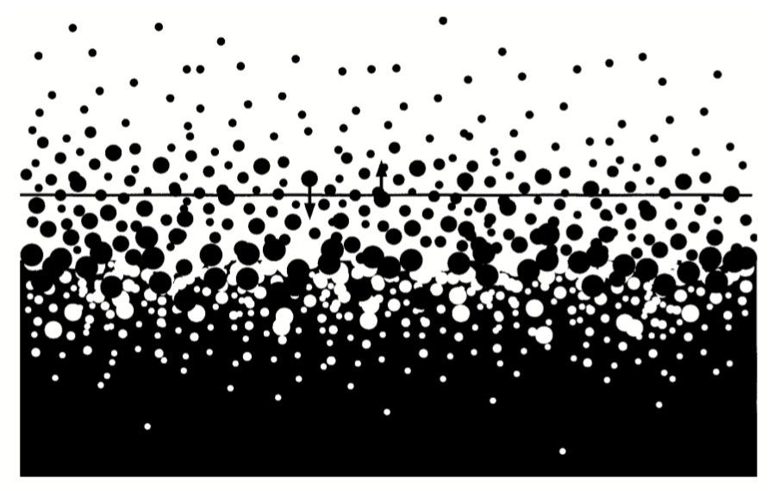
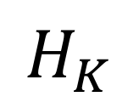


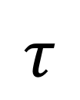
The sea surface is an enthalpy source and a momentum sink
$$H_{K}$$
$$τ$$
$$H_{K}=C_{K}ρ_{a}|U|Δk$$
$$τ=C_{D}ρ_{a}|U|U$$

Slide 6
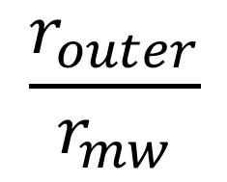

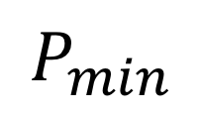

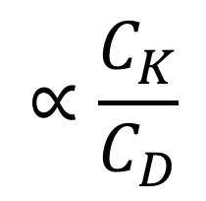
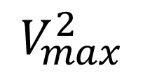
It is not uncommon to see $C_{K}=C_{D}=1×{10}^{−3}$
$$H_{K}$$
$$V_{max}^{2}$$
$$τ$$
$$P_{min}$$
$$∝\frac{C_{K}}{C_{D}}$$
$$\frac{r_{outer}}{r_{mw}}$$
$$H_{K}=C_{K}ρ_{a}|U|Δk$$
$$τ=C_{D}ρ_{a}|U|U$$
Emanuel (1986), Emanuel (1995a),Emanuel (2003)

Slide 7
Exchange Coefficient Formulations

Slide 8
Exchange Coefficient Formulations

Slide 9
Outline
0. Background
I. Sensitivity Analysis
Motivation: Improve hurricane intensity forecasts
Hurricane intensity depends on air-sea enthalpy and momentum fluxes
What do spray-mediated fluxes depend on?
What are they most sensitive to?
II. Synthesis of Previous Work
What trends or common
findings exist in the literature?

Slide 10
Outline
0. Background
I. Sensitivity Analysis
Motivation: Improve hurricane intensity forecasts
Hurricane intensity depends on air-sea enthalpy and momentum fluxes
What do spray-mediated fluxes depend on?
What are they most sensitive to?
II. Synthesis of Previous Work
What trends or common
findings exist in the literature?

Slide 11
Sea spray has to mediate the air-sea fluxes
Emanuel (2003)

Slide 12

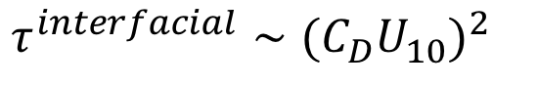
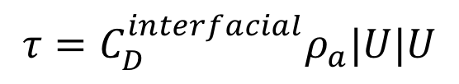
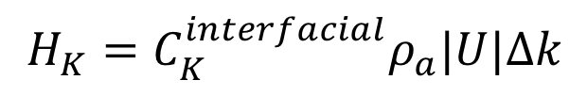
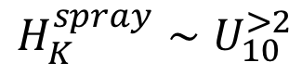
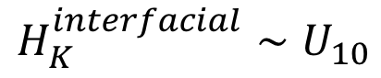
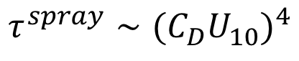
Interfacial Versus Spray Flux
low wind speeds
extreme wind speeds
$$H_{K}=C_{K}^{interfacial}ρ_{a}|U|Δk$$
$$τ=C_{D}^{interfacial}ρ_{a}|U|U$$
Andreas (2008)
Andreas and Emanuel (2001)
Emanuel (2003)
$$H_{K}^{interfacial}∼U_{10}$$
Richter and Stern (2014)
$$τ^{interfacial}∼{(C_{D}U}_{10})^{2}$$
$$H_{K}^{spray}∼U_{10}^{>2}$$
$$τ^{spray}∼{(C_{D}U}_{10})^{4}$$

Slide 13
Sea spray as an enthalpy source
Sea Surface Temperature
Ambient Air Temperature
Wet Bulb Temperature

Slide 14
Sea spray as an enthalpy source
Upon ejection, a drop rapidly cools to its wet bulb temperature without losing much mass (<1%)
Sea Surface Temperature
Ambient Air Temperature
Wet Bulb Temperature

Slide 15
Sea spray as an enthalpy source
Upon ejection, a drop rapidly cools to its wet bulb temperature without losing much mass (<1%)
Sea Surface Temperature
Ambient Air Temperature
After a long time aloft, a drop will
finish evaporating
warm to the ambient air temperature
Wet Bulb Temperature

Slide 16
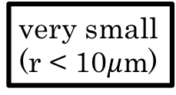
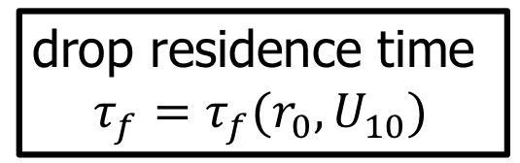
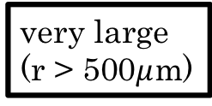
Sea spray as an enthalpy source
drop residence time
$$τ_{f}=τ_{f}(r_{0},U_{10})$$
Andreas (1992)
very large
(r > 500$μ$m)
most return
near T_{w}
very small
(r < 10$μ$m)
Andreas and Emanuel (2001)

Slide 17
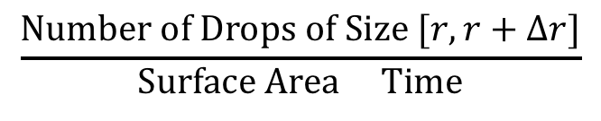
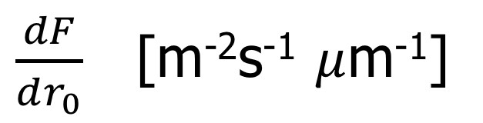
Sea Spray Generation Functions
$\frac{dF}{dr_{0}}$ [m⁻²s⁻¹ $μ$m⁻¹]
$$\frac{Number of Drops of Size [r,r+Δr]}{Surface Area Time}$$

Slide 18
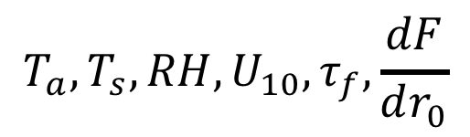
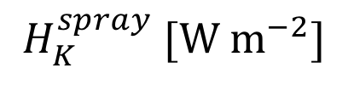
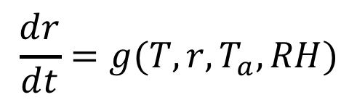
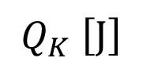
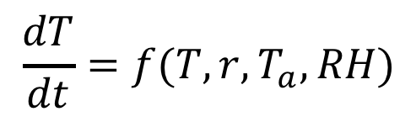
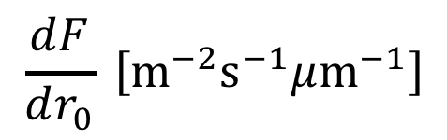
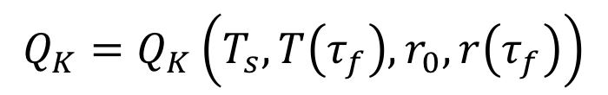
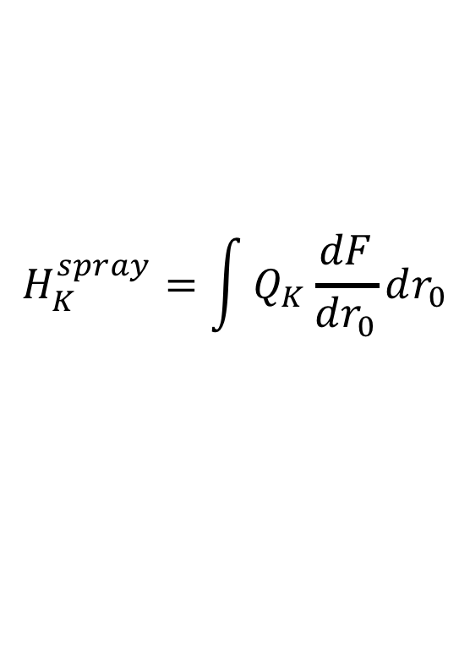
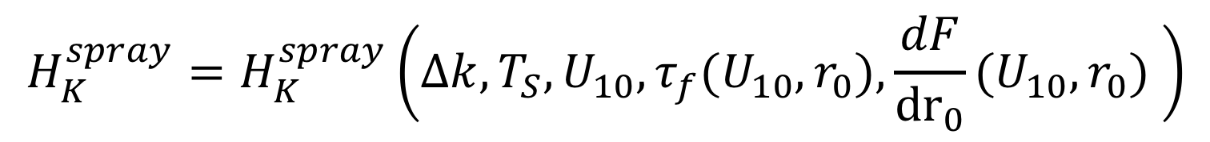
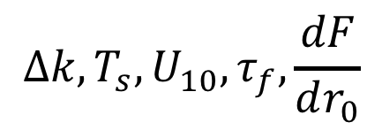
We show $H_{K}^{spray}$ is a function of only a few variables
Cumulative Enthalpy Flux
from A Single Drop
Cumulative Enthalpy Flux
from All Drops
Cumulative Enthalpy Flux
from All Drops
$$Q_{K}=Q_{K}\left(T_{s},T\left(τ_{f}\right),r_{0},r\left(τ_{f}\right)\right)$$
$$H_{K}^{spray}=\int{Q_{K}\frac{dF}{dr_{0}}}dr_{0}$$
$$T_{a},T_{s},RH,U_{10},τ_{f},\frac{dF}{dr_{0}}$$
$$\frac{dT}{dt}=f(T,r, T_{a},RH)$$
$$H_{K}^{spray} [W m^{−2}]$$
$$\frac{dr}{dt}=g(T,r,T_{a},RH)$$
$$Q_{K} \left[J\right]$$
$$Δk,T_{s},U_{10},τ_{f},\frac{dF}{dr_{0}}$$
$$\frac{dF}{dr_{0}} \left[m^{−2}s^{−1}μm^{−1}\right]$$
Pruppacher and Klett (1978)
Andreas (1989, 1990, 1992)
$$H_{K}^{spray}=H_{K}^{spray}\left(Δk,T_{S},U_{10},τ_{f}(U_{10},r_{0}),\frac{dF}{{dr}_{0}}(U_{10},r_{0}) \right)$$
*
*We also chose the formula for sea water density, the surface pressure to calculate the specific humidity, etc.

Slide 19
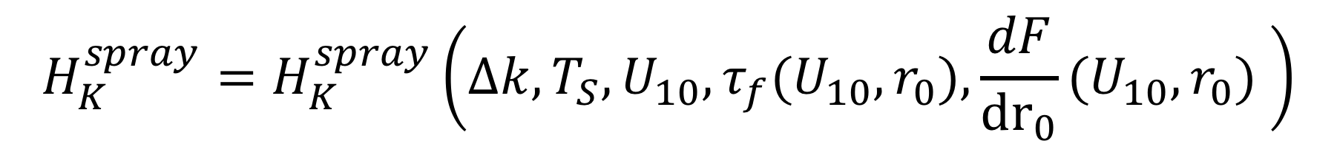
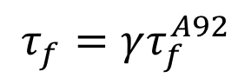
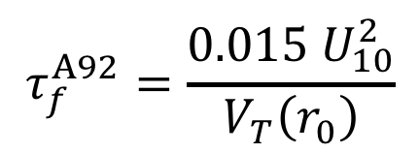
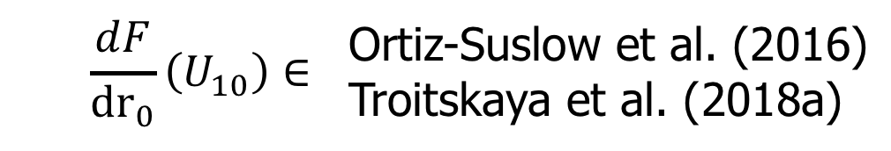
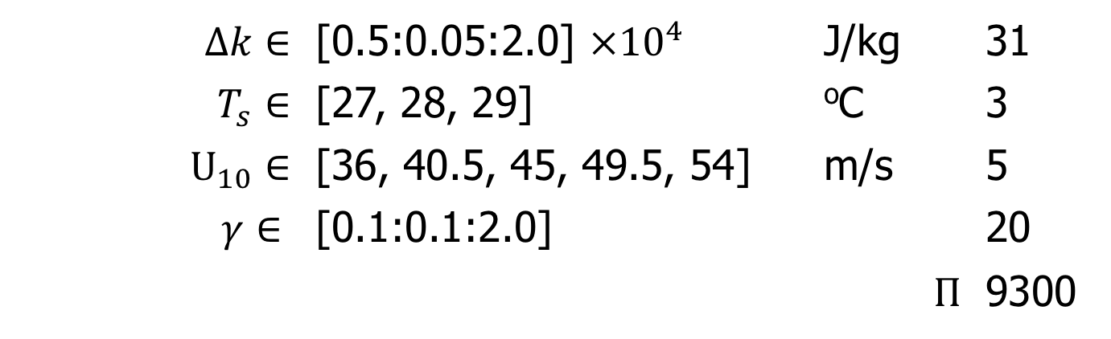
What is $H_{K}^{spray}$ most sensitive to?
$$H_{K}^{spray}=H_{K}^{spray}\left(Δk,T_{S},U_{10},τ_{f}(U_{10},r_{0}),\frac{dF}{{dr}_{0}}(U_{10},r_{0}) \right)$$
Number of Values
$Δk∈$ | [0.5:0.05:2.0] $×{10}^{4}$ | J/kg | 31
$T_{s}∈$ | [27, 28, 29] | ºC | 3
$U_{10}∈$ | [36, 40.5, 45, 49.5, 54] | m/s | 5
$$γ∈$$ | [0.1:0.1:2.0] |  | 20
 |  | $$Π$$ | 9300
$$τ_{f}^{A92}=\frac{0.015{ U}_{10}^{2}}{V_{T}\left(r_{0}\right)}$$
Andreas (1992)
$$τ_{f}=γτ_{f}^{A92}$$
$$\frac{dF}{{dr}_{0}}\left(U_{10}\right)∈$$ | Ortiz-Suslow et al. (2016) Troitskaya et al. (2018a)

Slide 20
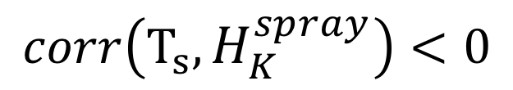
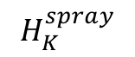
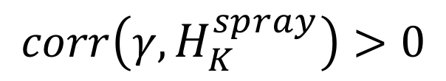
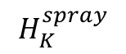
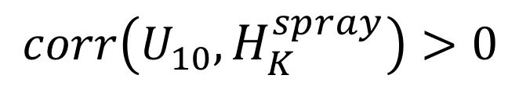
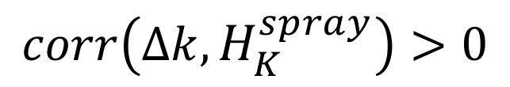
What is $H_{K}^{spray}$ most sensitive to?
Ortiz-Suslow et al. (2016)
Troitskaya et al. (2018a)
$$H_{K}^{spray}$$
$$H_{K}^{spray}$$
$$corr\left(U_{10},H_{K}^{spray}\right)>0$$
$$corr\left(Δk,H_{K}^{spray}\right)>0$$
$$corr\left(γ,H_{K}^{spray}\right)>0$$
$$corr\left(T_{s},H_{K}^{spray}\right)<0$$
Notes:
The reason the correlation with SST is negative is because of the way the microphysics handles the fixed RH and fixed DT, it means that the difference between the Ts and the Twetbulb is about 1% smaller

Slide 21
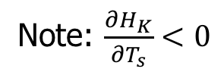
What is $H_{K}^{spray}$ most sensitive to?
Note: $\frac{∂H_{K}}{∂T_{s}}<0$
The largest sensitivity in the ensemble is for U₁₀
A 1% change in U₁₀ could effect a change in H_{K} on the order of 10%

Slide 22
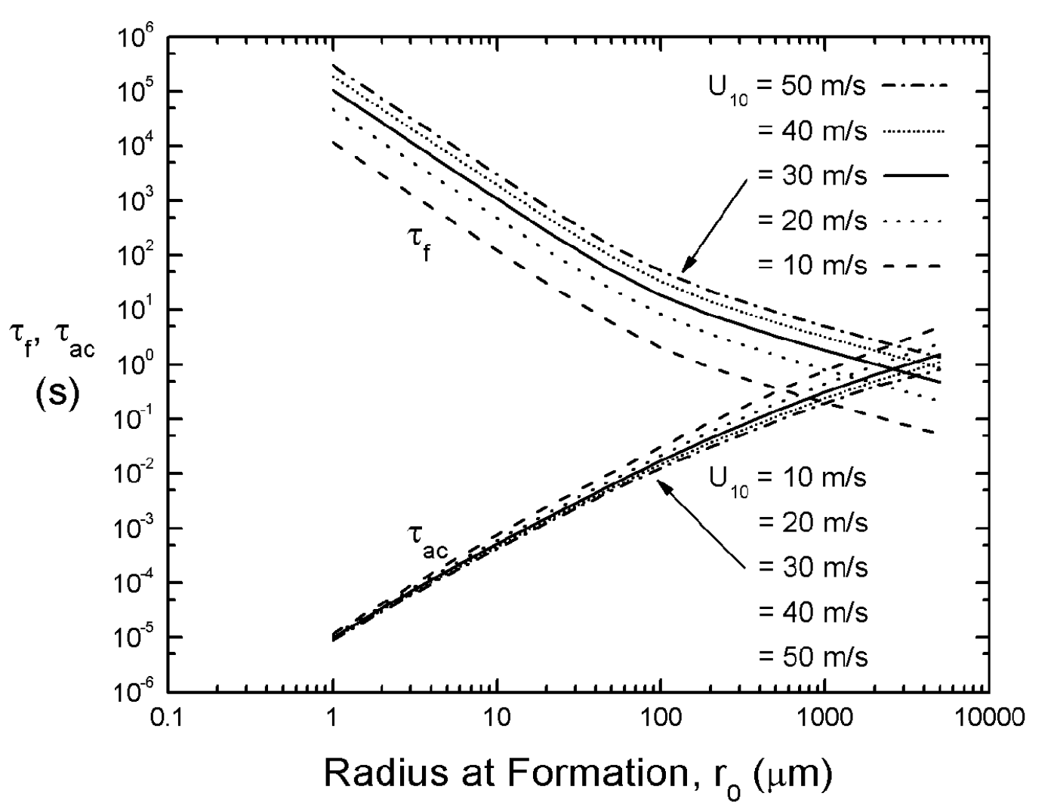

Sea spray as a momentum sink
applied shear accelerates drops
residence
time
time until drop is
within e⁻¹ of U₁₀
Emanuel (2003)
Andreas (2004)

Slide 23
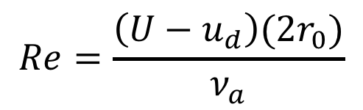
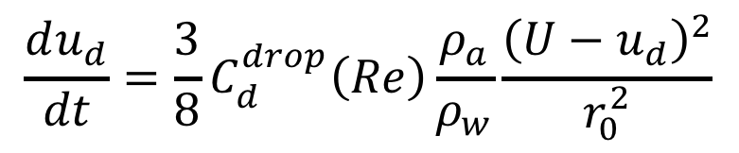
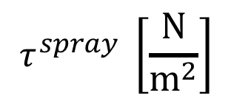
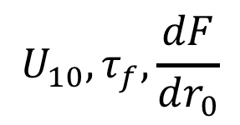
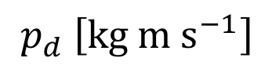
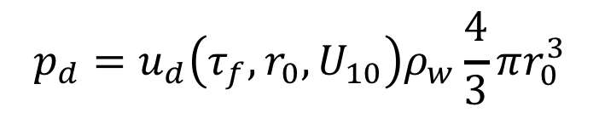



The spray stress $τ^{spray}$ is also a function of only a few variables
Momentum Flux From
A Single Drop
Cumulative Stress
from All Drops
Cumulative Stress
from All Drops
$$p_{d}=u_{d}\left(τ_{f},r_{0},U_{10}\right)ρ_{w}\frac{4}{3}πr_{0}^{3}$$
$$τ^{spray}=\int{p_{d}\frac{dF}{dr_{0}}}dr_{0}$$
$$U_{10},τ_{f},\frac{dF}{dr_{0}}$$
$$\frac{du_{d}}{dt}=\frac{3}{8}C_{d}^{drop}\left(Re\right)\frac{ρ_{a}}{ρ_{w}}\frac{{\left(U−u_{d}\right)}^{2}}{r_{0}^{2}}$$
$$τ^{spray} \left[\frac{N}{m^{2}}\right]$$
$$Re=\frac{\left(U−u_{d}\right)(2r_{0})}{ν_{a}}$$
$$p_{d} \left[kg m s^{−1}\right]$$
$$\frac{dF}{dr_{0}} \left[m^{−2}s^{−1}μm^{−1}\right]$$
Andreas (2004), Clift (1978)
$$τ^{spray}=τ^{spray}\left(U_{10},τ_{f}(U_{10},r_{0}),\frac{dF}{{dr}_{0}}(U_{10},r_{0}) \right)$$
*
*We also chose the formula for sea water density, the air density, etc.

Slide 24





What is $τ^{spray}$most sensitive to?
$$τ^{spray}=τ^{spray}\left(U_{10},τ_{f}(U_{10},r_{0}),\frac{dF}{{dr}_{0}}(U_{10},r_{0}) \right)$$
Number of Values
$U_{10}∈$ | [36, 40.5, 45, 49.5, 54] | m/s | 5
$$γ∈$$ | [0.1:0.1:2.0] |  | 20
 |  | $$Π$$ | 100
$$τ_{f}^{A92}=\frac{0.015{ U}_{10}^{2}}{V_{T}\left(r_{0}\right)}$$
$$\frac{dF}{{dr}_{0}}\left(U_{10}\right)∈$$ | Ortiz-Suslow et al. (2016) Troitskaya et al. (2018a)
Andreas (1992)
$$τ_{f}=γτ_{f}^{A92}$$

Slide 25


What is $τ^{spray}$most sensitive to?
$$corr\left(γ,τ^{spray}\right)>0$$
$$corr\left(U_{10},τ^{spray}\right)>0$$

Slide 26

What is $τ^{spray}$most sensitive to?
The largest sensitivity in the ensemble is for U₁₀
A 1% change in U₁₀ could effect a change in $τ^{spray}$ on the order of 10%

Slide 27
Outline
0. Background
I. Sensitivity Analysis
Motivation: Improve hurricane intensity forecasts
Hurricane intensity depends on air-sea enthalpy and momentum fluxes
What do spray-mediated fluxes depend on?
What are they most sensitive to?
II. Synthesis of Previous Work
What trends or common
findings exist in the literature?

Slide 28

Outline
0. Background
I. Sensitivity Analysis
Motivation: Improve hurricane intensity forecasts
Hurricane intensity depends on air-sea enthalpy and momentum fluxes
We showed spray-mediated fluxes…
only depend on 𝛥k, T_{s}, U₁₀, $τ_{f}$, $\frac{dF}{dr_{0}}$
are most sensitive to uncertainty in U₁₀
II. Synthesis of Previous Work
What trends or common
findings exist in the literature?

Slide 29
Outline
0. Background
I. Sensitivity Analysis
Motivation: Improve hurricane intensity forecasts
Hurricane intensity depends on air-sea enthalpy and momentum fluxes
We showed spray-mediated fluxes…
only depend on 𝛥k, T_{s}, U₁₀, $τ_{f}$, $\frac{dF}{dr_{0}}$
are most sensitive to uncertainty in U₁₀
II. Synthesis of Previous Work
What trends or common
findings exist in the literature?

Slide 30
Synthesis of Results
Review of Sea Spray Parameterizations
The early studies indicating sea spray fluxes were important for hurricane thermodynamics
The different proposed formulations for C_{K}, C_{D}, and the sea spray generation functions along with some possible explanations for the observed disagreement
The many studies which find a sea surface regime transition at about U₁₀ = 30 m/s
The gradual shift away from the ‘interfacial flux’ and towards to the ‘spray flux’
Three common techniques for estimating the surface fluxes in the presence of spray:
in situ observations
laboratory experiments
numerical simulations
Sroka, S. and Emanuel, K. (Submitted). A Review of Parameterizations for Enthalpy and Momentum Fluxes from Sea Spray in Tropical Cyclones. Journal of Physical Oceanography.

Slide 31
Common finding: A Regime Transition Near 30 m/s
 | Method | Transition Speed U₁₀ [m/s] | C_{K}, C_{D}, both
Emanuel (2003) | Theoretical Model | 30 (gradient wind) | both
Powell et al. (2003) | GPS Sonde Data | 40 | C_{D}
Donelan et al. (2004) | Laboratory Experiment | 33 | C_{D}
French et al. (2007) | In Situ (flight level) | 25 | C_{D}
Jarosz et al. (2007) | In Situ (ocean Buoy) | 32 | C_{D}
Holthuijsen et al. (2012) | GPS Sonde Data | 40 | C_{D}
Troitskaya et al. (2018a) | Laboratory Experiment | 10 (Re_{B} ~4000, 8000) | both
Komori et al. (2018) | Laboratory Experiment | 35 | both
¹
²
¹100% Whitecap Fraction Reached
²New Spray Production Mechanism Characterized: bag-breakup

Slide 32











Spray has been getting more…”credit” over time
Zhao et al. (2006)
$$U_{10}≈50 (Re_{B}≈{10}^{6})$$
$$τ_{spray}∼τ$$
$$U_{10}≈5 (Re_{B}≈{10}^{5})$$
$H_{K}^{spray}∼H_{K}$
Richter and Stern (2014)
“…enthalpy fluxes within hurricanes are likely dominated by spray at high winds.” (U₁₀ > 60 m/s)
Andreas and Decosmo (2001)
$U_{10}<18$m/s
$$10\% H_{K}< H_{Latent}^{spray}<40\%H_{K}$$
Andreas (2010)
$U_{10}<40$m/s
$$H_{Sensible}^{spray}≈10\% H_{K}$$
$$H_{K}^{spray}≈50\%H_{K}$$
Andreas (1992)
Troitskaya et al. (2018b)
U₁₀ $≈$60 m/s
$$H_{K}^{spray}≈55\% H_{K}$$
$$τ^{spray}=20\% τ$$
$U_{10}<20$m/s
Andreas (2004)
$U_{10}<30$m/s
$τ^{spray}=10\% τ$
$U_{10}>60$m/s
$τ^{spray}= 100\% τ$
$$31\% H_{K}^{Latent}$$
$$26\% H_{K}^{Sensible}$$

Slide 33
Outline
0. Background
I. Sensitivity Analysis
Motivation: Improve hurricane intensity forecasts
Hurricane intensity depends on air-sea enthalpy and momentum fluxes
We showed spray-mediated fluxes…
only depend on 𝛥k, T_{s}, U₁₀, $τ_{f}$, $\frac{dF}{dr_{0}}$
are most sensitive to uncertainty in U₁₀
II. Synthesis of Previous Work
What trends or common
findings exist in the literature?

Slide 34
Questions
0. Background
I. Sensitivity Analysis
Motivation: Improve hurricane intensity forecasts
Hurricane intensity depends on air-sea enthalpy and momentum fluxes
We showed spray-mediated fluxes…
only depend on 𝛥k, T_{s}, U₁₀, $τ_{f}$, $\frac{dF}{dr_{0}}$
are most sensitive to uncertainty in U₁₀
II. Synthesis of Previous Work
Emerging Trend: spray-mediated fluxes dominate at high wind speeds
Common Finding: the sea surface transitions around U₁₀= 30 m/s

